Slide 1






Internal training deck
2026-03-14
Understanding
AI
Training
From Prediction to Research Applications

Slide 2






01
02
What is AI? (Prediction)
How AI Predicts (Tokens)
03
04
CONTENTS
AI Memory (Context Window)
How to Talk to AI (Prompting)
Contents
05
06
AI Tools for Research
AI in Our Company
07
Future of Research with AI
02

Slide 3
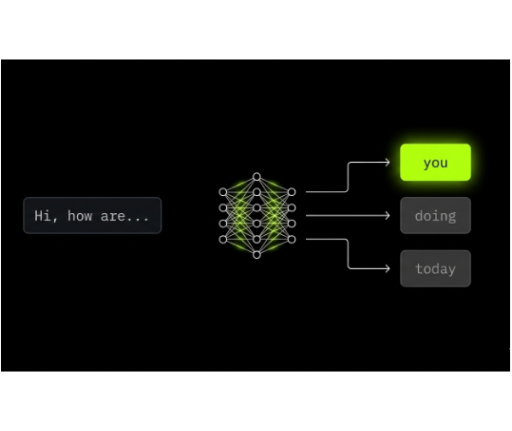



What is Artificial Intelligence?
AI predicts what comes next based on patterns it learned from data.
How it mirrors humans:
We consider context before speaking
We choose the most likely next word/action
Prediction Process
“Hi, how are …”
you
doing
today
Sentence
Model “thinking”
Candidate next words
Chosen prediction
3

Slide 4











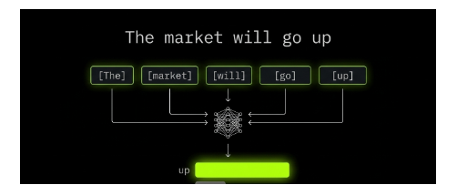
How AI Predicts
Tokenization Example
Models read text as tokens (small pieces) and predict the next token.
Input Sentence:
“The market will go up”
[The]
[ market]
[ will]
[ go]
[ up]
1
Input text is split into tokens
Next Token Probability:
up
85%
down
10%
flat
5%
2
Tokens are processed to estimate probabilities of possible next tokens
3
The most probable token is selected to continue the sequence
4

Slide 5








AI Memory (Context Window)
AI answers using the most recent conversation it can “see” (the context window).
Hi, can you help me analyze this data?
What this means:
Sure! Please provide the dataset.
Recent messages strongly influence the response
Here is the CSV file...
Context Window
Older messages outside the window may be ignored
I see the data. It contains sales figures for Q1-Q3.
Practical Takeaway
Great. Focus only on Q3 trends and ignore Q1-Q2.
Put key requirements close to the end of your prompt
Restate constraints when the conversation gets long
AI Processing
Response Generation
5

Slide 6







How to Talk to AI
Prompt Structure Example
Strong prompts clarify Role, Context, and Task.
ROLE
CONTEXT
TASK
Research Analyst
Strategy rules
Find trading strategy ideas
Role
WORKFLOW
Who the AI should act as
Context
Background, constraints, definitions
Task
Deliverable + format
06

Slide 7











AI Tools for Research
Think of AI as a toolbox—different tools for different research tasks.
Research & Idea Generation
Summaries, hypotheses
Excel Help
Formulas, transformations
Data Analysis Assistance
RESEARCH TOOLKIT
Quick interpretations, explanations
Output Examples
Charts
Reports
Spreadsheets
07

Slide 8



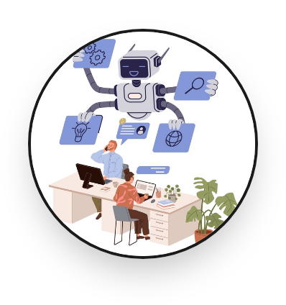



AI in Our Company
AI reduces repetitive work so analysts spend more time on decisions.
Manual
AI-Assisted
Before
After
Time-consuming Excel cleanup
Automate Excel tasks
Speed up research analysis
Slow iteration on analysis and write-ups
Generate strategy ideas faster
08

Slide 9








Future of Research with AI
AI becomes a day-to-day research assistant that accelerates learning loops.
Faster idea testing
Faster strategy discovery
More time on judgment and risk checks
Workflow Shift
Analyst questions
AI analysis
AI Assistant Active
Insights draft
Processing market signals • Risk assessment complete
Human validation
Final output
09

Slide 10


Thank You
Q&A
Contact: (add team email/Slack channel)

